Slide 1
Enhancing Public Support for International Sanctions
Dag van het gedrag, 2023
Elena Kantorowicz-Reznichenko
Professor of Quantitative Empirical Legal Studies
Erasmus University Rotterdam
(with Jaroslaw Kantorowicz, Leiden University)

Slide 2
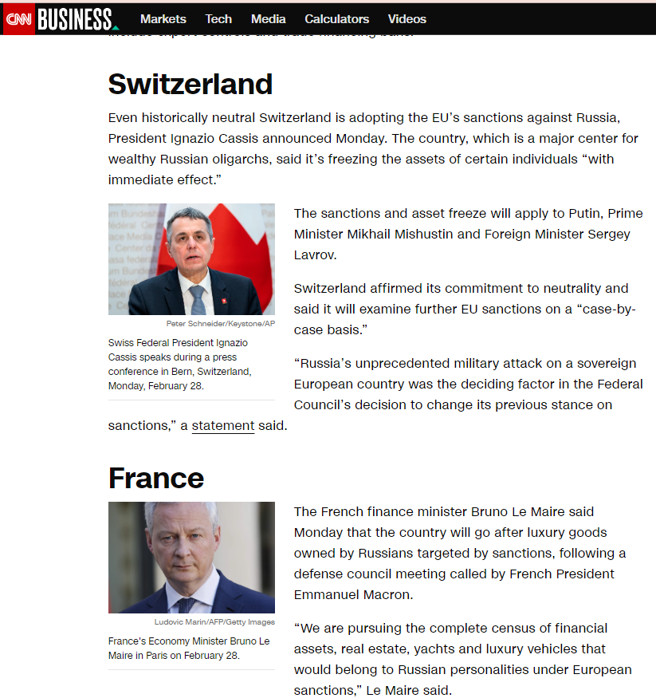
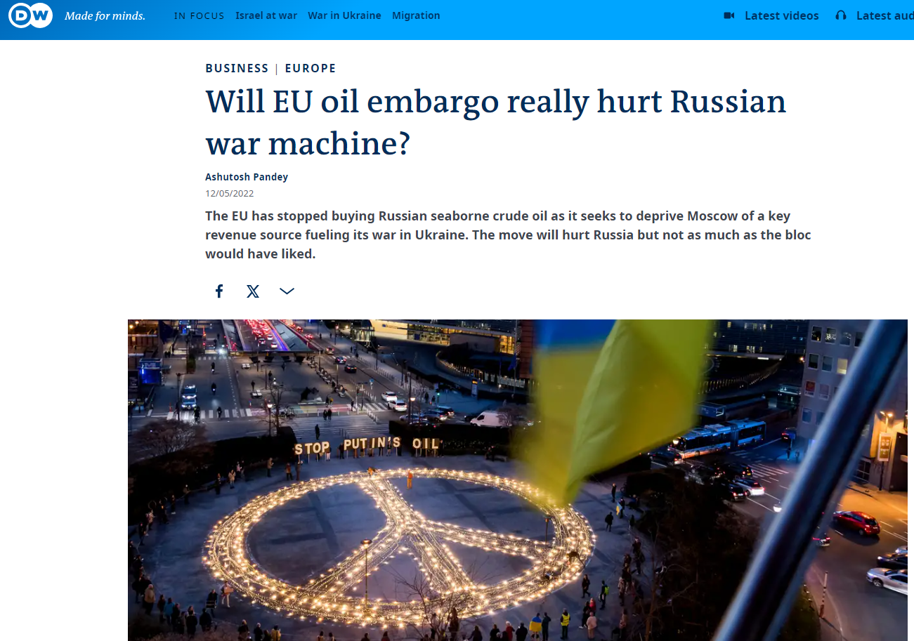
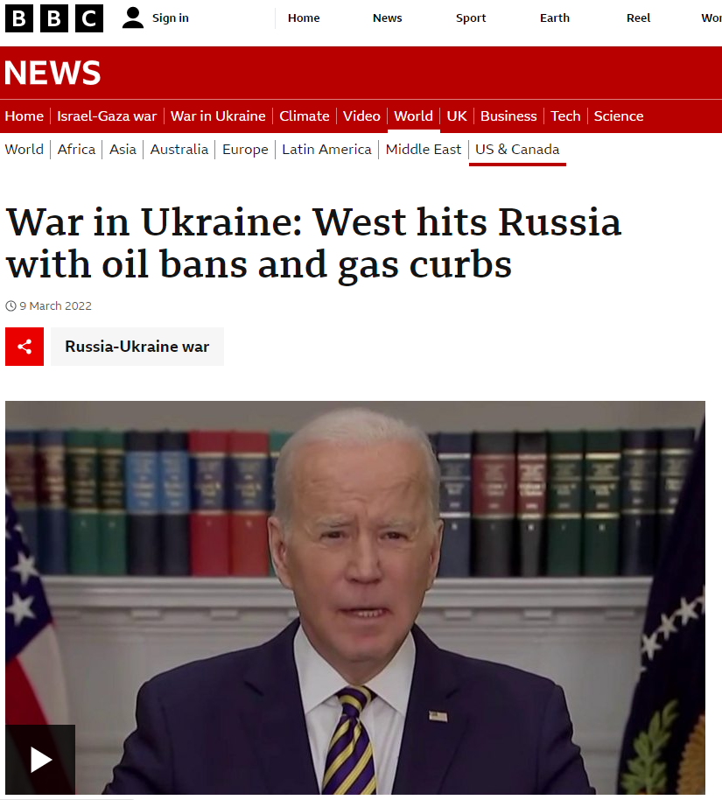
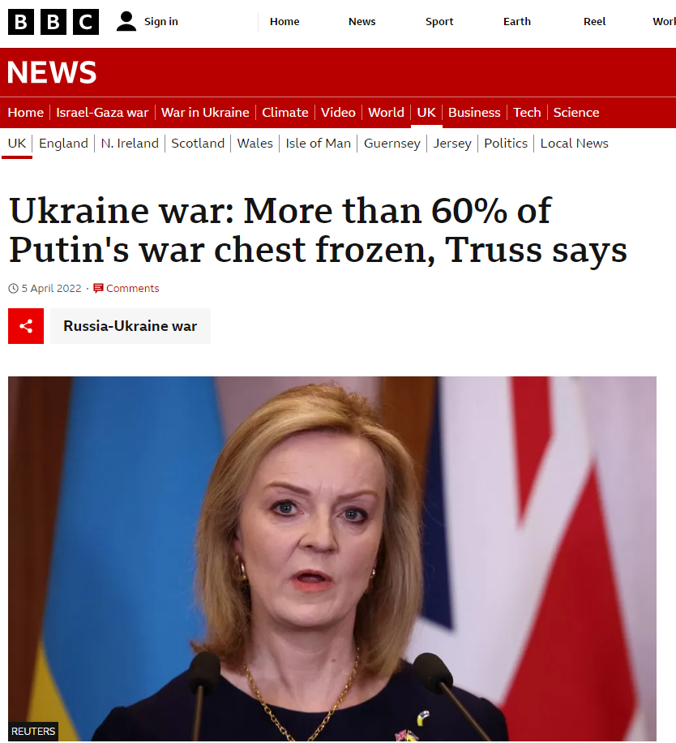
Motivation

Slide 3
The Current Study
RQ: Can public support for sanctions be enhanced through sanctioning regime design, or through framing of the domestic costs of such sanctions?
Context: the war in Ukraine, international sanctions on Russia (oil, gas, and coal embargo)
2 experimental studies, representative samples Germany and Poland (N=1,152/1,117), May 2022

Slide 4
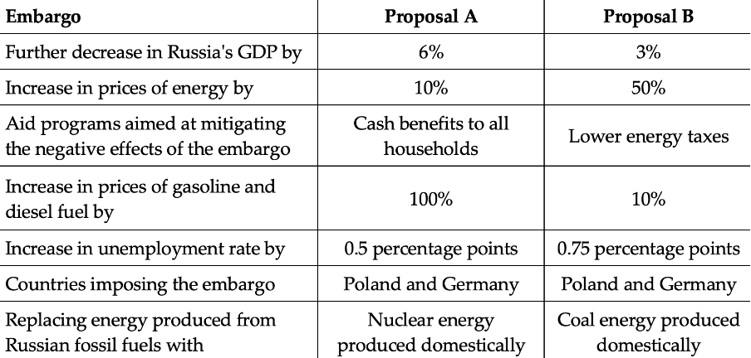
Study 1
Conjoint experiment
Sanctioning regime design
Choice between pairs of sanctioning regimes

Slide 5
Study 1
Attribute | Levels
Increase in prices of gasoline and diesel fuel by | 10% 25% 50% 100%
Increase in prices of energy by | 10% 25% 50% 100%
Increase in unemployment rate by | 0.5 percentage points 0.75 percentage points 1 percentage points 1.5 percentage points
Further decrease in Russia's GDP by | 1% 3% 6% 10%
Aid programs aimed at mitigating the negative effects of the embargo | Cash benefits to low-income households Cash benefits to all households Lower energy taxes No aid program in place
Replacing energy produced from Russian fossil fuels with | Nuclear energy produced domestically Renewable energy produced domestically Coal energy produced domestically Energy imports from other countries
Countries imposing the embargo | All European Union member states Germany, Poland, France, Spain and Italy Germany and Poland Germany/Poland
The different elements of the sanctioning regime (attributes and their levels)

Slide 6
Study 1
Results (aspect-support)
Sanctioning aspect | Support
Domestic costs
Target’s costs
Aid programs
Sustainable energy substitutes
# Sanctioning countries

Slide 7
Study 2
Information provision experiment
Updating believes
Baseline average estimated GDP loss: 12.2% / 14.2% (PL/DE)
Framing of domestic costs
Self-report + behavioral measures

Slide 8
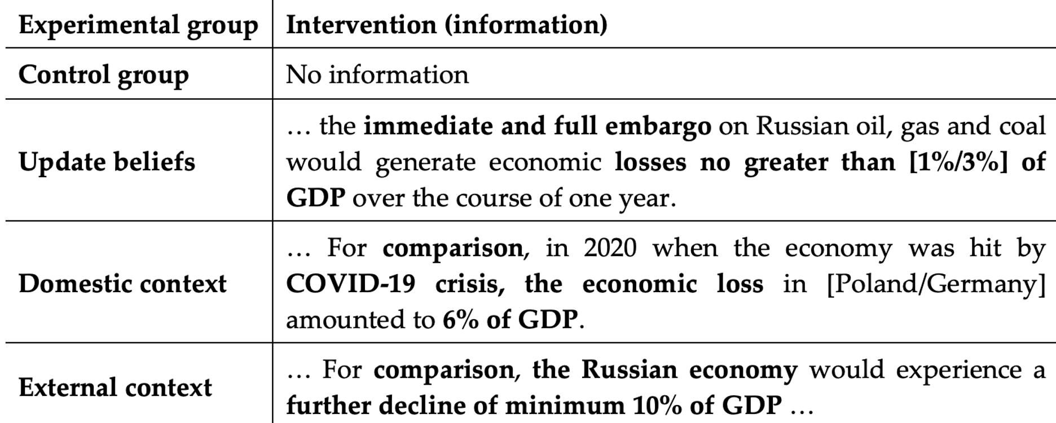
Study 2
Experimental intervention

Slide 9
Study 2
Self-report measure
Perception: “The potential economic costs for the [Polish/German] economy of the immediate and full embargo on Russian oil, gas and coal are too high”
Support: “The government should introduce the immediate and full embargo on Russian oil, gas and coal”
(1=strongly disagree; 7=strongly agree)

Slide 10
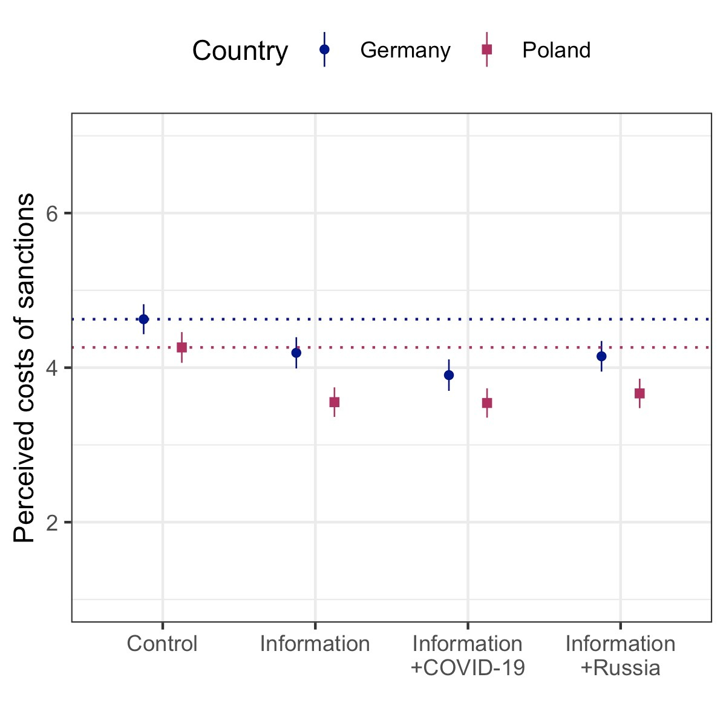
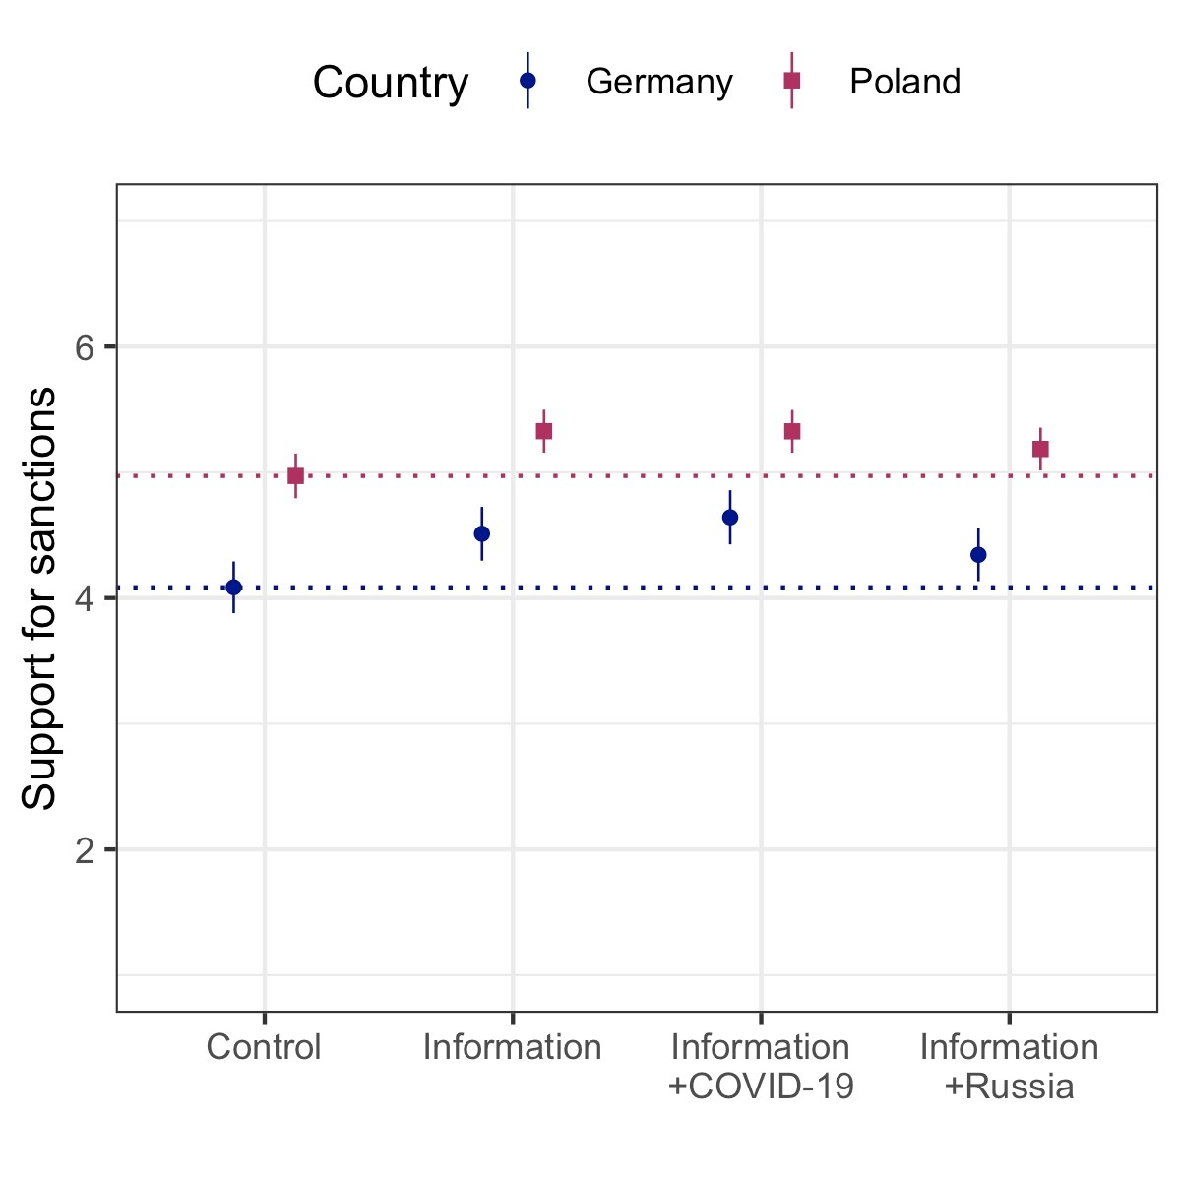
Study 2
Self-report measure: results
“The potential economic costs for the [Polish/German] economy of the immediate and full embargo on Russian oil, gas and coal are too high”
“The government should introduce the immediate and full embargo on Russian oil, gas and coal”

Slide 11
Study 2
Behavioral measure
Number identification task (NIT)
Incentive: contribution to NGO that strongly supports the end of Russian oil and gas imports
Willingness to participate: out of 3 pages
Correct completion: 90% correctly identified numbers

Slide 12
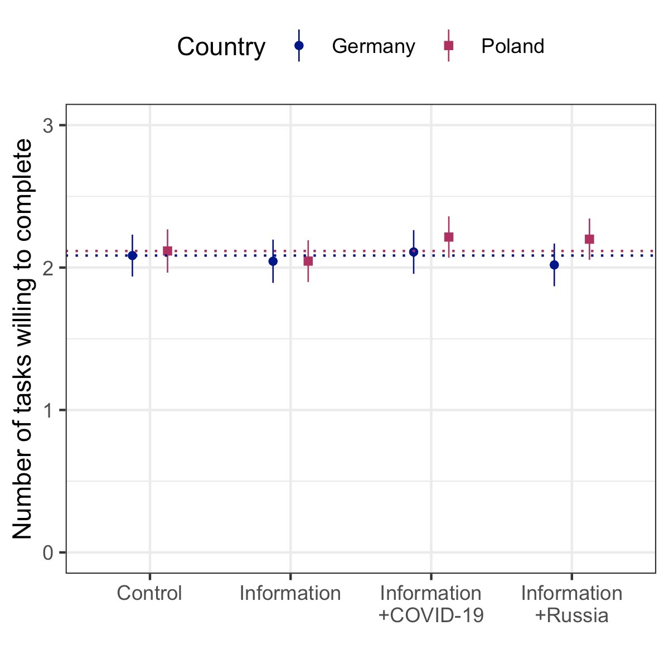
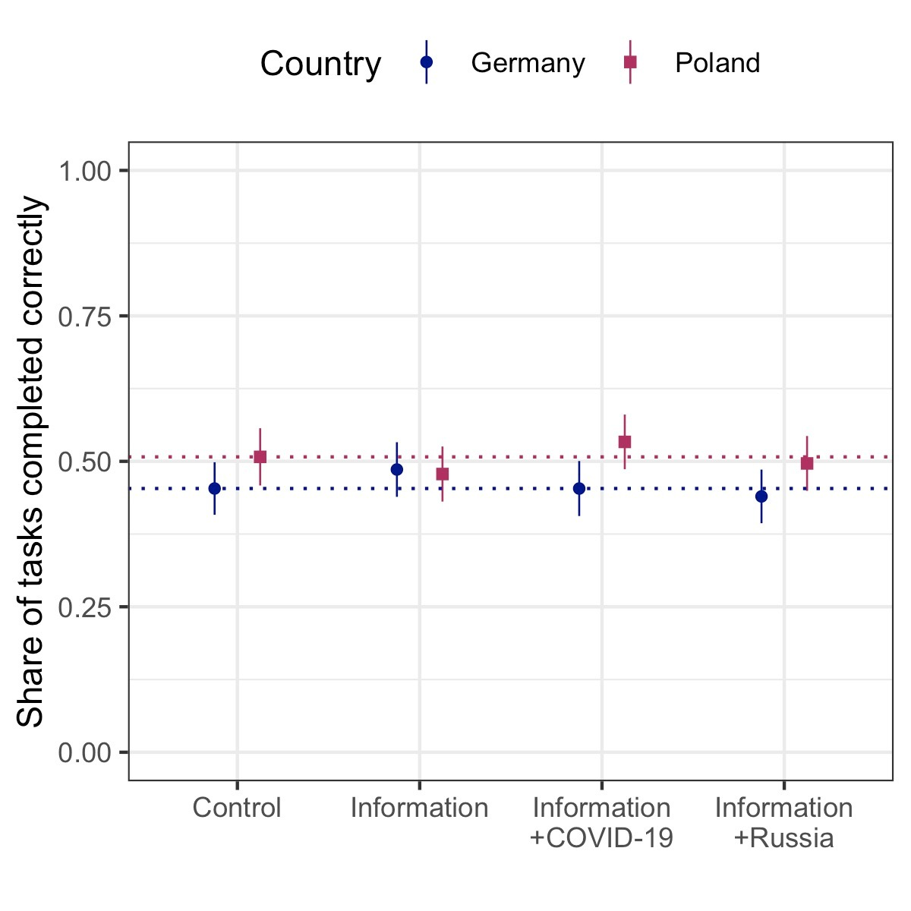
Study 2
Behavioral measure: results

Slide 13
Conclusions
The design of the sanctioning regime matters for public support
Different domestic policies can enhance support for the sanctions
“Correction” of perceived domestic costs may enhance reported support for sanctions
This support did not translate into action
Contrasting the costs of sanctions with other costs did not have an additional effect.
Limitations and future research
Other contexts
Other countries
Behavioral measure, why did not work?
People indeed do not want to take action
People did not believe in the effectiveness of the NGOs
Supporting through no objection easier than active support?

Slide 14
Thank you for your attention!
Q&A

